Slide 1

HUGH BOYD SECONDARY SCHOOL
Meet the Teacher Evening
Notes:
Roz

Slide 2

“We acknowledge and thank the First Peoples of the Hən̓q̓əmin̓əm̓ language group on whose traditional and unceded territories we teach, learn and live.”
Notes:
Roz

Slide 3

Meet the Teacher Shape of the Evening
Land Acknowledgement
Welcome & Introductions
Our School
Health and Safety
Middle Years Program
Notes:
Roz

Slide 4
Introductions:
Principal
  Mr. Leslie
Vice Principals:
  Mr. Onukwulu
  Ms. Poon
Notes:
Roz

Slide 5
Counsellors
Counsellors:
  Mr. Lam (A-L)
  Mr. McDonnell (M-Z)
  Ms. Takada
Support:
  Orientation to the school
  Individual counselling of a social or personal nature
  Guidance in course selections and timetables
  Information for educational planning
  Liaison between student-teachers-parents
  Referral to community and professional services
Notes:
Roz

Slide 6
Our School
Hugh Boyd develops compassionate and respectful young adults who are well-balanced, principled inquirers with an understanding of their responsibilities within society and as global citizens.
75+ caring adults in various roles supporting students
Enrolls approximately 680 students
Offers a wide range of curricular and extracurricular programs including the Middle Years Program (8-10), Incentive Program and Advanced Placement courses for senior students
Notes:
Roz

Slide 7

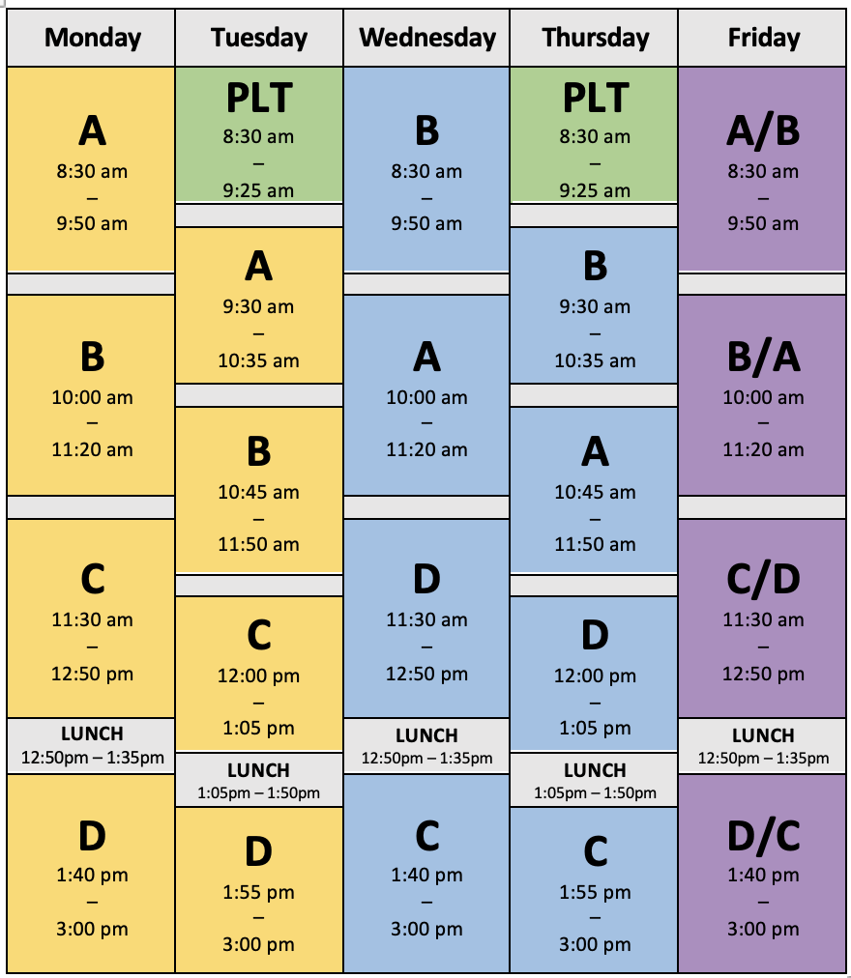
Courses & Bell Schedule
Notes:
Roz

Slide 8

My School Day - App
Available on App Store/Play Store
Province>School District>School
  Receive notifications and check announcements from school
  Enter your schedule and extra-curricular activities
  Record homework and set reminders for each class
Notes:
Roz

Slide 9
Personal Learning Time (PLT)
Dedicated time on Tuesdays and Thursdays
8:30 – 9:25am
Develop personal skills: organization, time management, communication, problem solving, etc.
Choice: academic support, catch up on missed tests/quizzes, labs, group work, complete homework and assignments, personal projects, post-secondary and scholarship applications, etc.
Notes:
Roz

Slide 10
Student Supports
Teacher and Learning Resource Supports
Personal Learning Time (PLT) - twice a week
Counselling Services – educational, personal and career supports
Resource department-learning hub
Career Advisor
  Mr. Ng
Notes:
Harinder

Slide 11
Library Learning Commons
open 8:00am to 4:00pm in quiet, supervised space
students able to borrow technology like iPads, laptops, microphones, etc for class work
open for PLT-quiet space to study or collaborate with classmates
  50 person limit during PLT-sign up available
  study, homework, read, collaborate, self directed learning/inquiry. Must be working something
no student ID needed to borrow, no late fines
students are allowed to eat in the library-safe space at lunch, breaks, before & after school
Notes:
Harinder

Slide 12
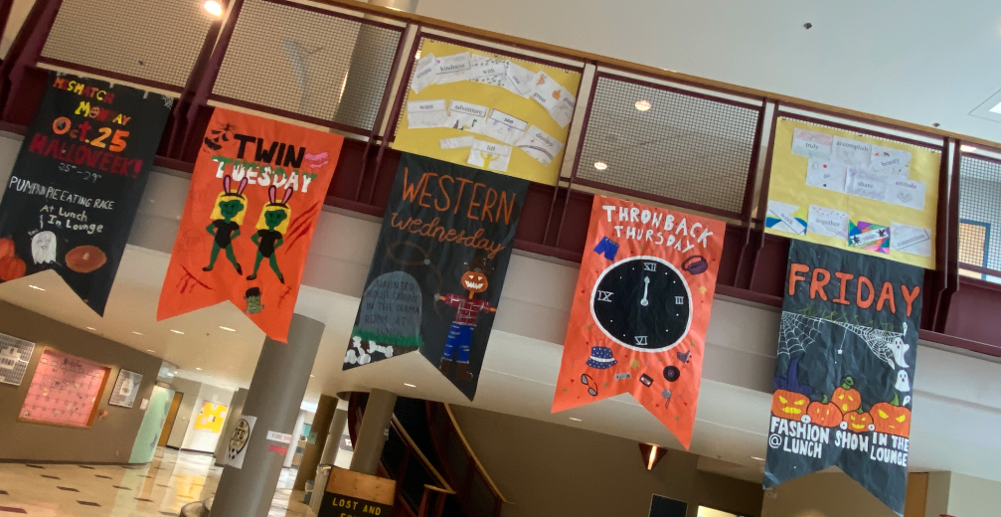
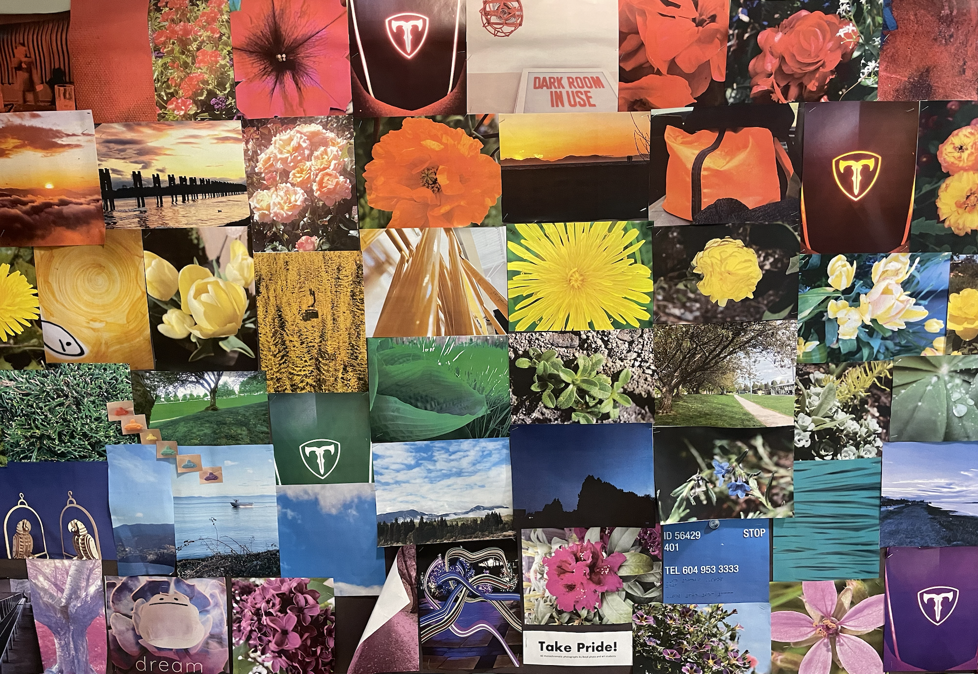
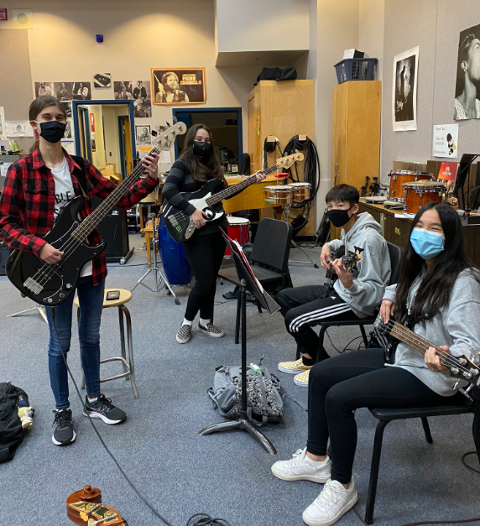

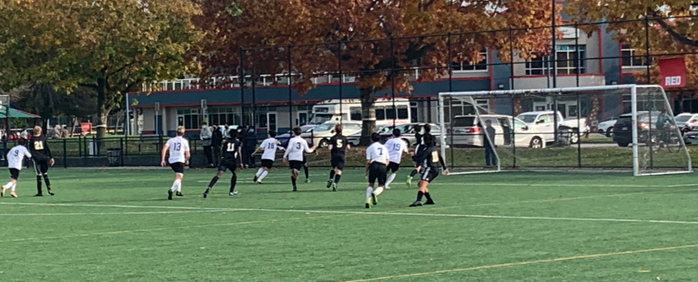
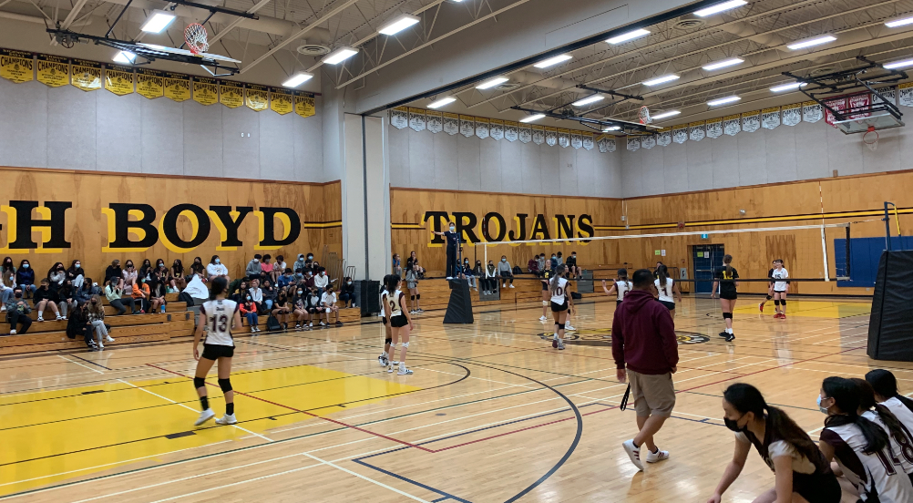
How to get involved
Clubs
Teams
Notes:
Harinder

Slide 13

Health and Safety
general health check before coming to school each day.​
should not come to school if they are sick and unable to participate in fully routine activities​
Early warning – report at 604-668-6615

Slide 14
How parents can get involved
Open communication with home and school
Be engaged with your child’s learning
Parent Advisory Council (PAC)

Slide 16
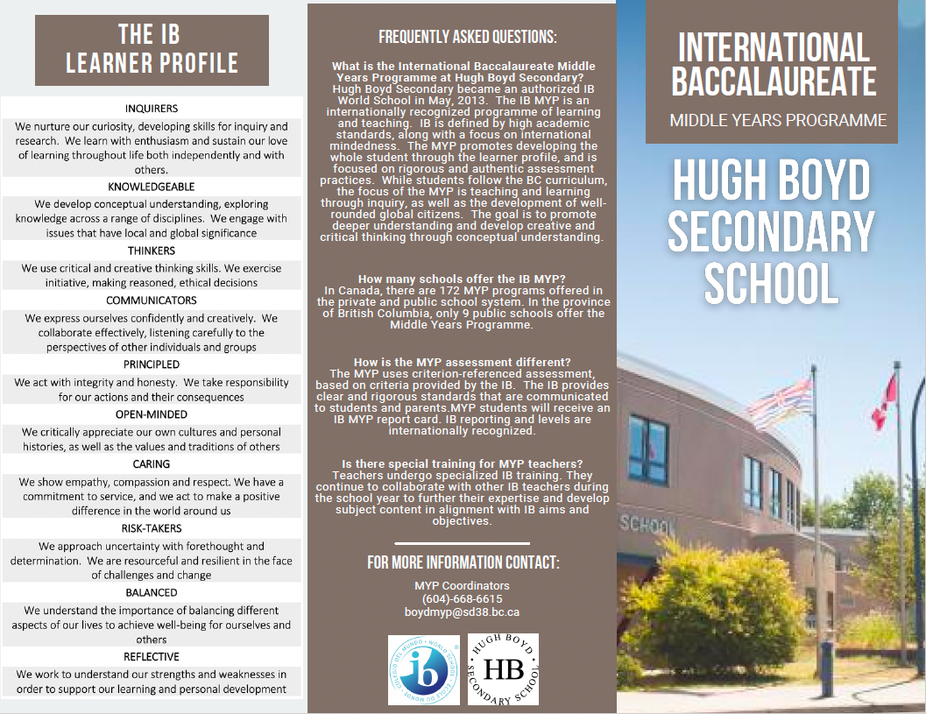
Middle Years Program (MYP)

Slide 17
Theme for year-
Be Kind,
Be honest, be respectful, be humble
Notes:
Off to homeroom

Slide 18
Teachers unable to be here tonight
Ms. Kasper
Ms. Jacobsen
Ms. Hayden
Ms. Lekakis
Ms. Leung (librarian)
Please contact them by phone or email if you have questions or wish to speak with them…

