Slide 1
Service Learning in the middle years programme
What the hours mean, why it’s important, and how to document

Slide 2
IB Learners strive to be caring members of the community who demonstrate a personal commitment to service, and act to make a positive difference to the lives of others and the environment” (Principles).

Slide 3
What is service learning?
In the classroom:
Investigating
Preparing
Taking Action
Demonstrating
Reflecting
At Hugh boyd:
Volunteering For Student Council, Rotary, Greenthumbers, Volunteer Club, Scorekeeping, Team Managing, etc
In the community:
Helping with the food bank, animal shelter, youth nights, etc
Notes:
Not: chores, playing on a team, going to meetings

Slide 4
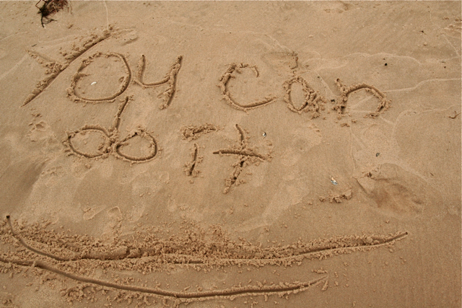
Learning objectives
Become more aware of your own strengths and areas of growth
Take on challenges that develop new skills
Discuss, evaluate, and plan student-started activities
Persevere in action
Work collaboratively with others
Develop international mindedness by engaging with the world, and understanding others who speak different languages and from different cultures
Think about the ethical implications of your actions.

Slide 5
How to record your MYP service learning HOURS

Slide 6
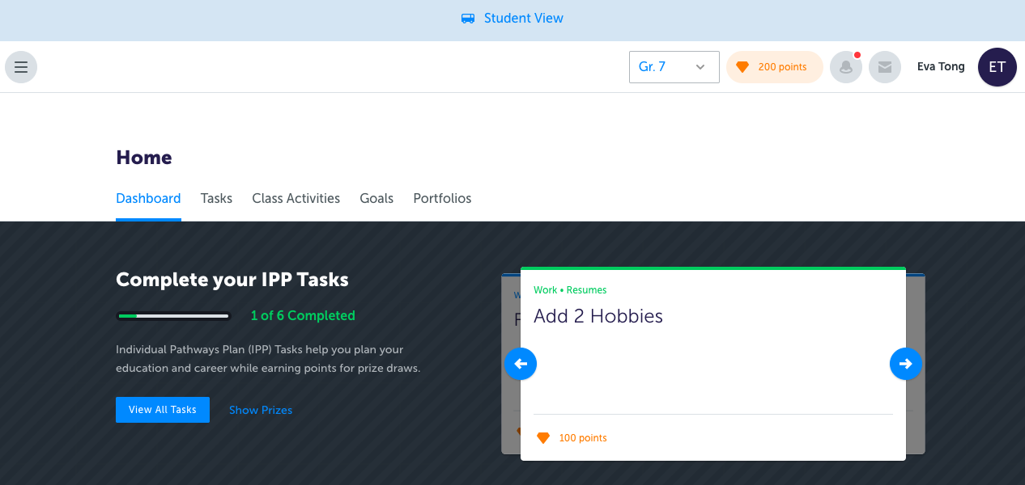
Log into “myblueprint.ca
On your dashboard, go to either ”My files” or “class activities”
Click on “Service&Reflection.2019.pdf” to access a fillable PDF form

Slide 7
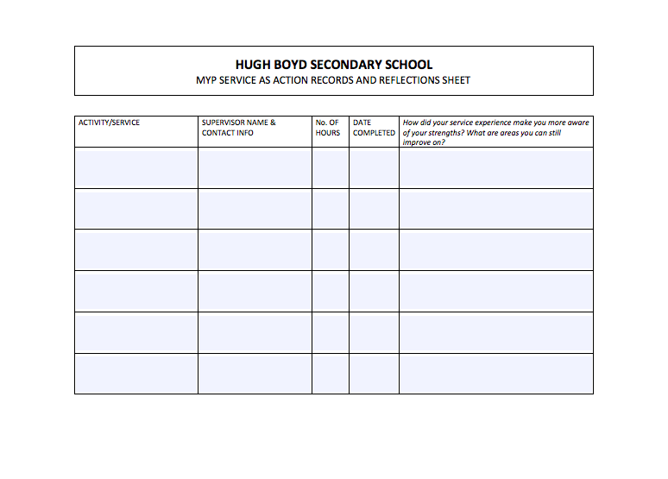
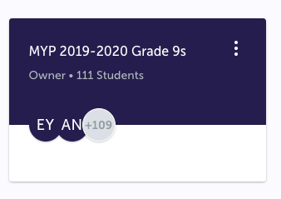
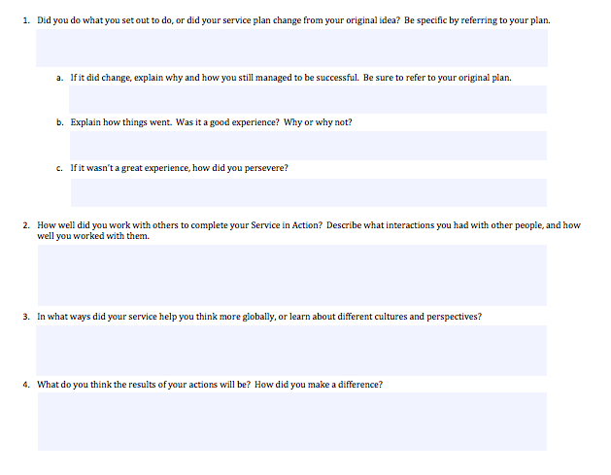
Log into “myblueprint.ca
On your dashboard, go to either ”My files” or “class activities”
Click on “Service&Reflection.2019.pdf” to access a fillable PDF form
Record your service hours as you complete them (Reflections as well)
Make sure to SAVE the PDF (or else all your work will be lost!)
Upload PDF to class “MYP 2019-2020 Grade 9s”

Slide 8
REMINDER:
To be eligible for MYP completion and distinction certificates you must complete 10 hours in each year for 30 hours in total

Slide 9
MYP Service learning and school awards
MYP Service learning:
10 hours in each year-Gr 8, 9 AND 10 for a total of 30 hours
Completed on MYBLUEPRINT.CA
Classroom, school, or community
Reflection on service required each year
School awards
Minor awards: 30-100 hours
Major awards: 100+ hours
Service to school only
Completed via link on boyd.sd38.bc.ca
NO DOUBLE DIPPING!!!

Slide 10
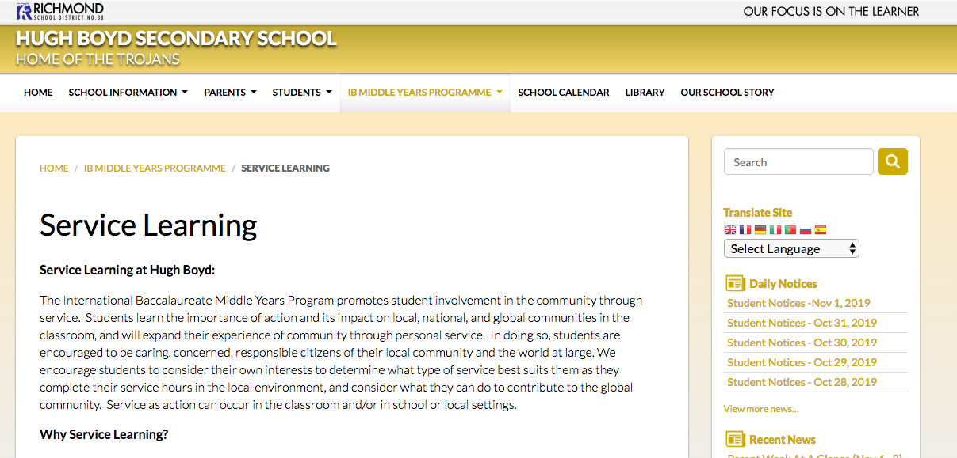
BE THE CHANGE
Powerpoint and further instructions can be found on
boyd.sd38.bc.ca → IB Middle Years Program → Service Learning
Questions? See Ms. Tong or Mrs. Korber

