Slide 1
School Moniker Committee (SMC)
About Us
June 2023

Slide 2
Thanks for reading our slides!!
We’re the School Moniker Committee (SMC) and we’d like to share some of our thoughts on the Trojan moniker and some updates on the work we’ve been doing this semester.
We think it is time for Hugh Boyd to move on from the Trojan moniker, and the Tommy Trojan mascot and logo, and replace it with something else!

Slide 3
Why we are moving away from the Trojan moniker
1) The Trojan name is not in-line with broader societal shifts that acknowledge importance of diversity and inclusion
2) We need a name that is representative of our increasingly diverse community and the unceded land we live, work, and play on. This is not accomplished with a name that has no real historical ties to Richmond, nor when a mascot or school logo is a buff white man. Let’s do better!
***But that doesn’t mean we are erasing history → we can still acknowledge our history as the Trojans because it is part of our story, but it is time to start writing a new chapter!
***Again, we are open to your ideas, so please reach out and attend one of our meetings! We meet every Wednesday and Friday in Mr. Smythe’s art room.

Slide 4
What We Are Getting Up To This Month (June 2023)
Working with the school district to complete an Indigenous Protocol form. We want to ensure the local indigenous community are partners and involved in this new moniker process, otherwise we risk repeating the mistakes of the past.
Staff and student suggestions for new school moniker → stop by on Wed or Fri at lunch and drop your suggestions in the ‘ballot box’, or, better yet, complete the online survey!
Prepping for September → We’ve got lots of work ahead of us, so stay tuned for more announcements!

Slide 5
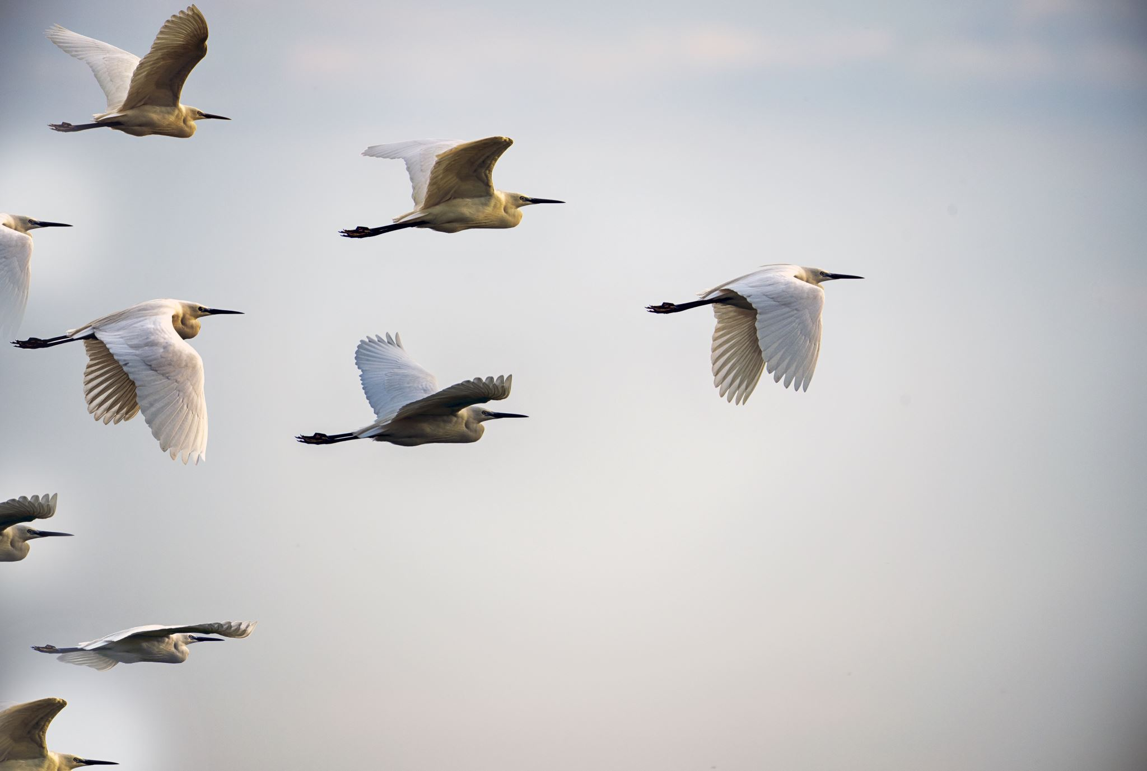
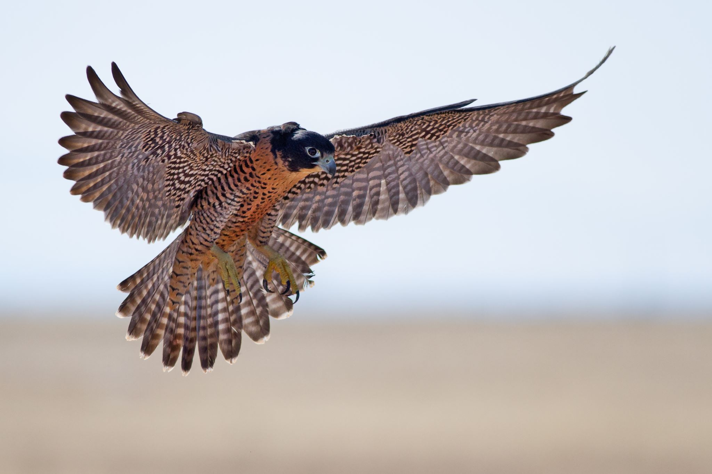
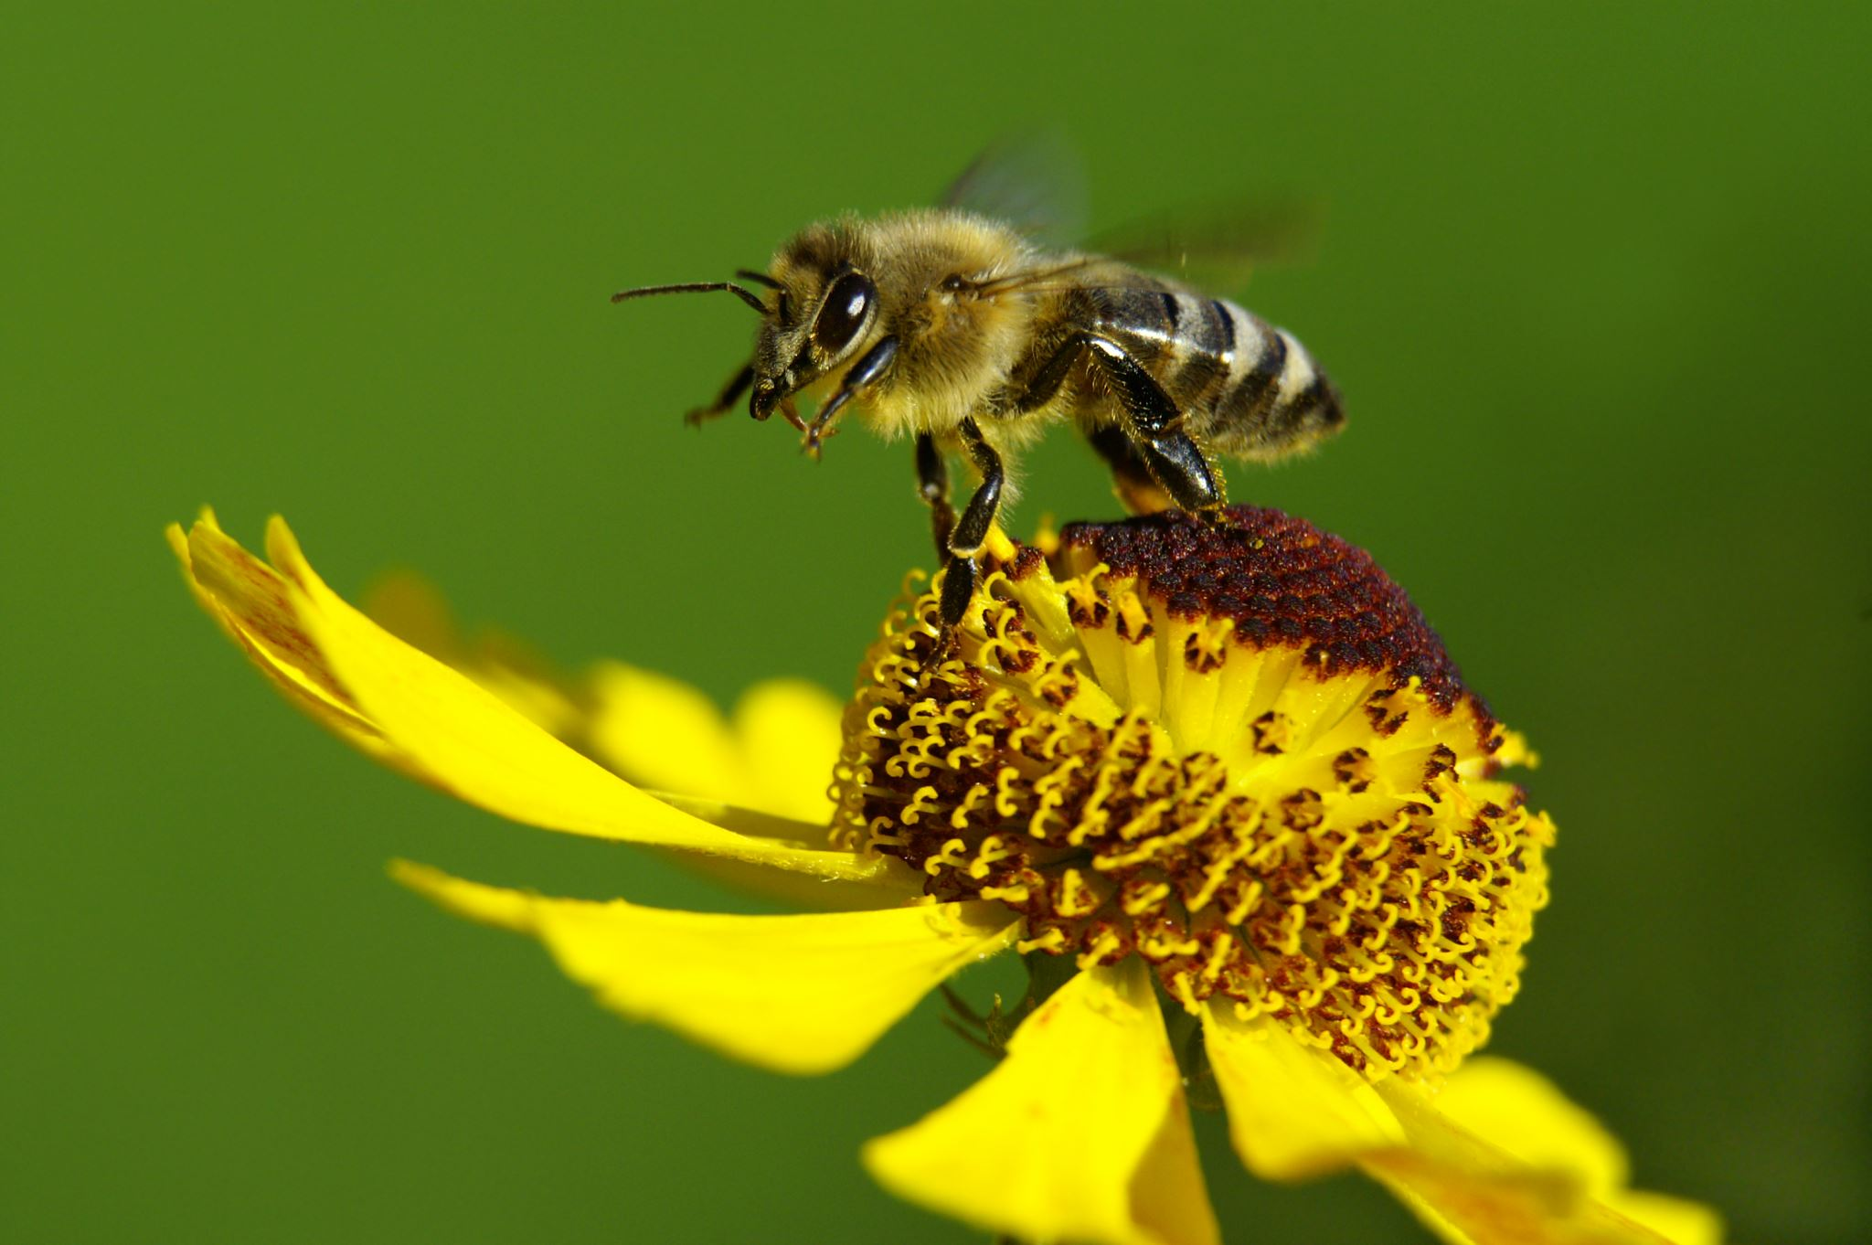
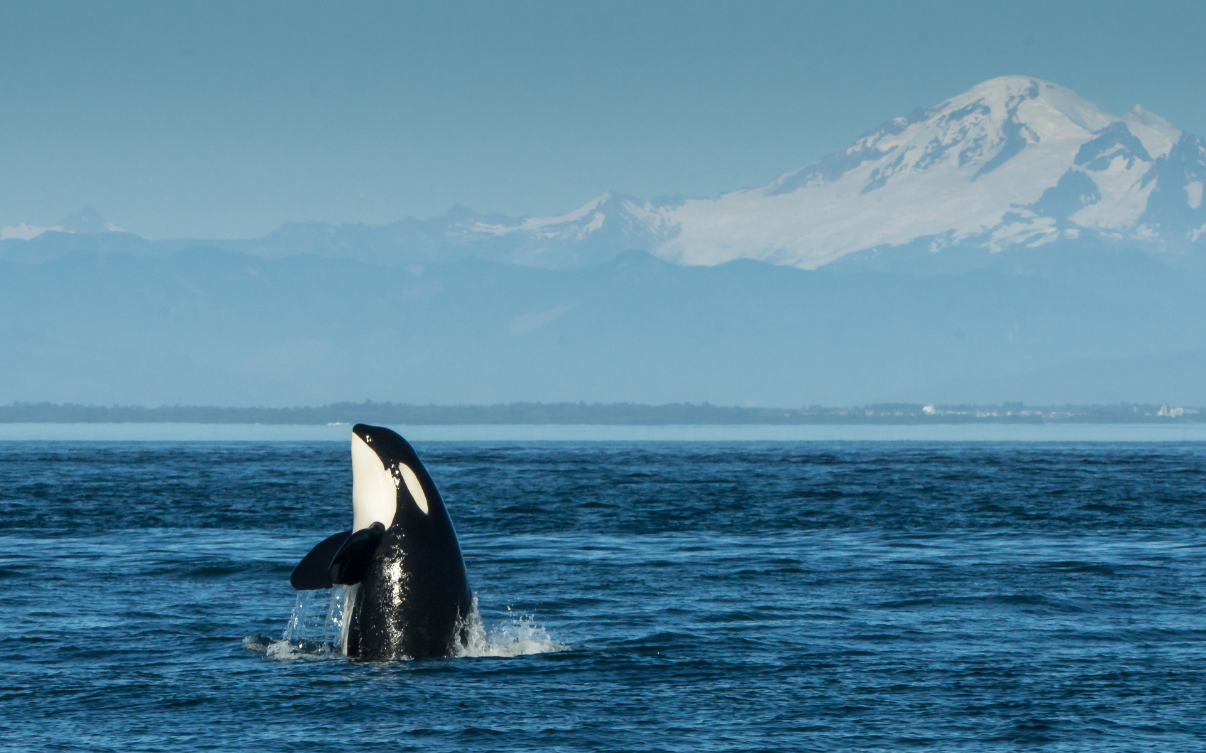
Good-Bye Hugh Boyd Trojans, Hello Hugh Boyd….
From Trojans to:
Hawks
Hornets
Honey Bees
Herons
Black Bears
Bats
Orcas
Marmots
Badgers
Beavers
Other ideas?
***Again, please complete the survey or come by on Wednesdays and Fridays at lunch and share your moniker ideas with us! We’d love to hear from you.

Slide 6
THANKS FOR READING OUR SLIDES!!!!!!

