Slide 1
School Moniker Survey: Results
June 15-22nd

Slide 2
The Results are in!!!!
Some quick numbers:
146 responses
130 students
13 Boyd staff
3 parents

Slide 3
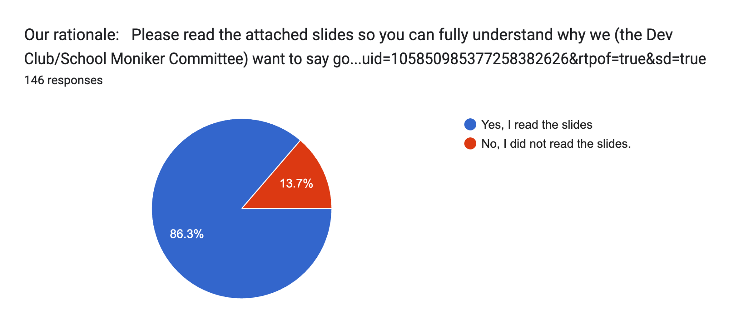
Results for Question 1

Slide 4
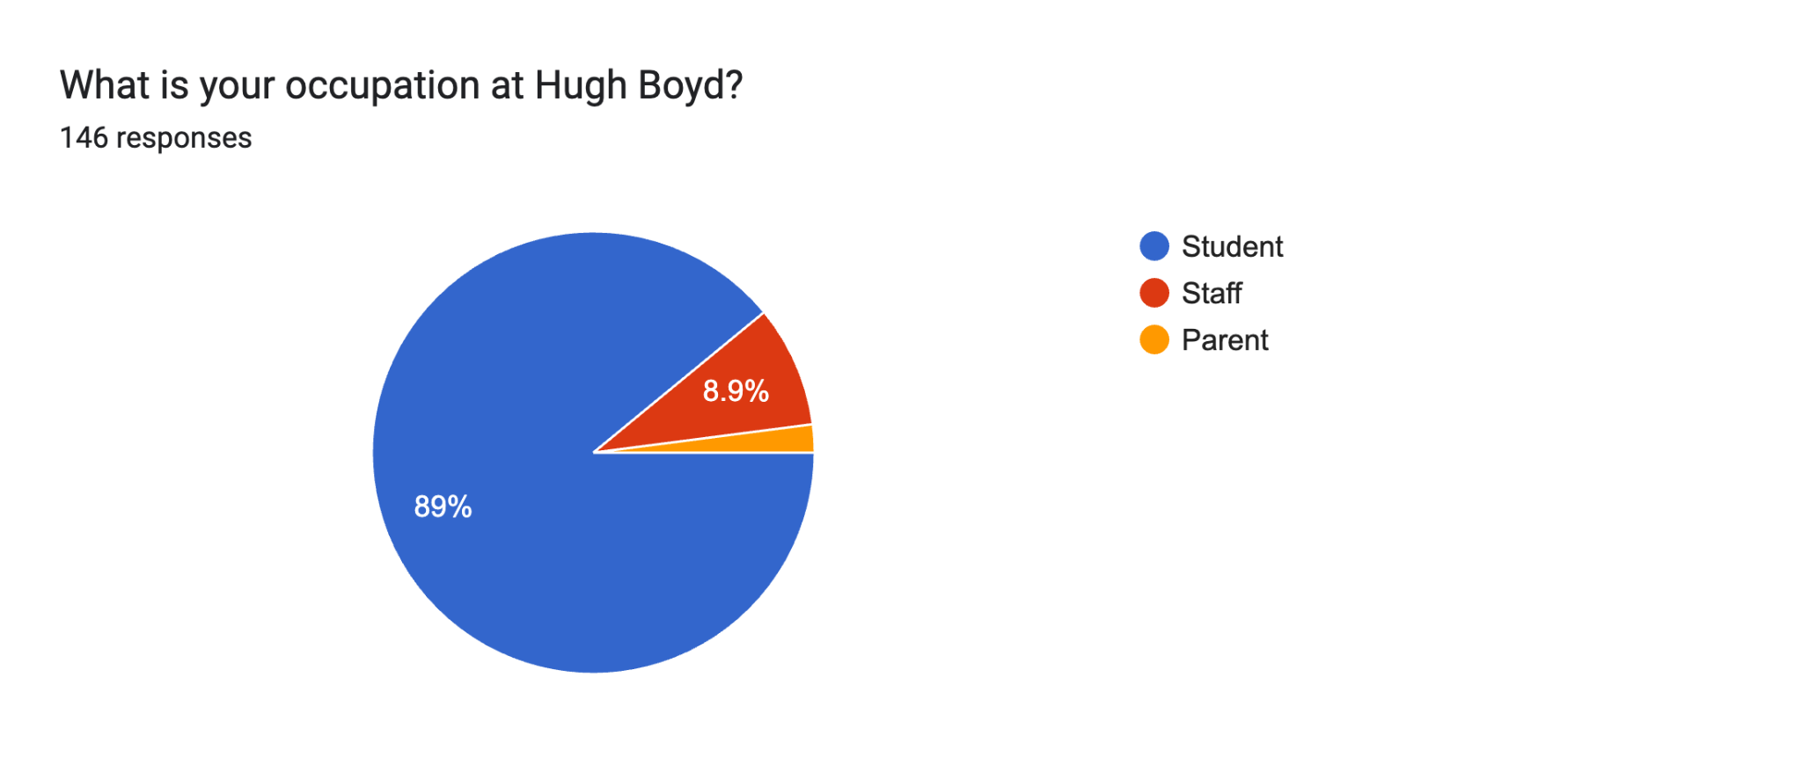
Results for Question 2

Slide 5
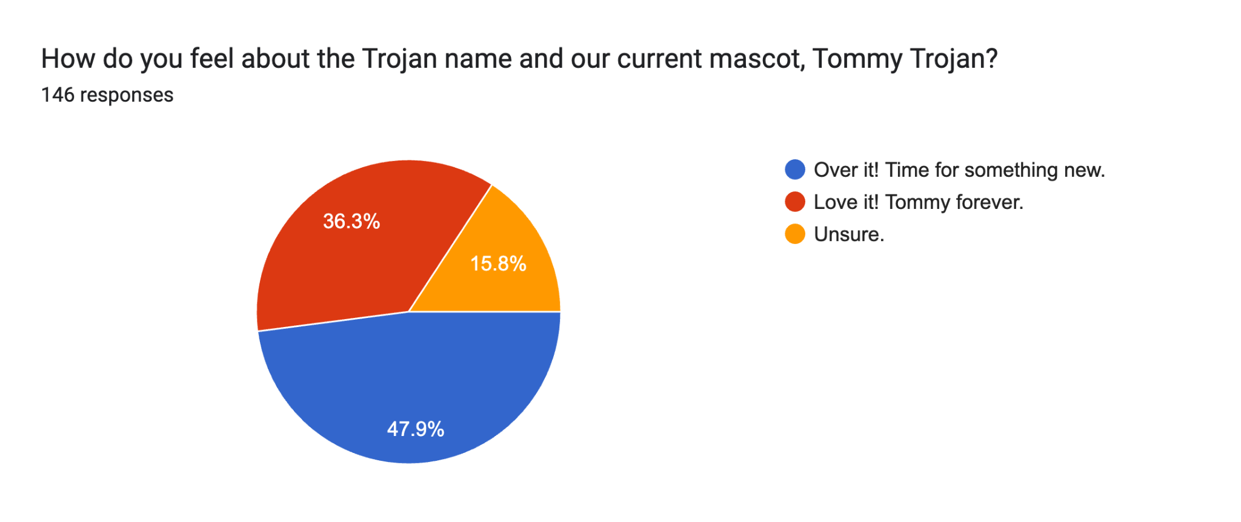
Results for Question 3

Slide 6
Results for Question 4
For this question, respondents wrote their answers, so we can’t present results in chart form. But the top 5 suggestions for a new school moniker were, in no particular order:
Hugh Boyd Hawks
Hugh Boyd Hornets
Hugh Boyd Bears
Hugh Boyd Honey Bees/Boyd Bees
Hugh Boyd Honey Badgers/Boyd Badgers
*Honourable mention: Hugh Boyd Herons

Slide 7
Results for Question 5
Similar to question 4, respondents wrote their answers, so we can’t present results in chart form. However, the overwhelming majority of respondents wanted:
A NEW MASCOT
And
2) A NEW LOGO

Slide 8
WANT A SAY? Join the Dev Club!
The Dev Club is a club dedicated to student-led activism. We want to make our school AND the city of Richmond a better place to learn, live, and play.
All members of the Dev Club automatically become members of the School Moniker Committee (SMC). The SMC is chaired by Mr. Smythe, with assistance from Ms. Minato and Ms. Leung. We currently have six student members but want at least twice as many (12) students on the committee! (We meet every Wed and Fri at lunch.) Our main piece of activism next year will creating the new school moniker, but we believe we can tackle other issues too so please join!
Follow us on Instagram (@boyddevclub) and/or leave us your email and we’ll contact you in September!

