Slide 1
Overcoming Distractions
Big thank you to slidesgo.com for providing this slides template!
How to reduce screen time & practice focus and concentration

Slide 2
Part 1:
The Wake-Up: How Technology Affects Us

Slide 3
Smartphone Compulsion Test
Developed by Dr. David Greenfield
Psychiatry professor at the University of Connecticut School of Medicine
link to view questionnaire
If you don’t have phone, think about another piece of tech-
Count up how many questions apply to you.
How many did you get?

Slide 4
Smartphone Compulsion Test
Test score interpretations
1-2: Your behavior is unproblematic
3-4: Your behavior is leaning toward problematic or compulsive use
5-7: It is likely that you may have a problematic or compulsive smartphone use pattern
8+: It is extremely possible that you are addicted to your phone

Slide 5
Smartphone Compulsion Test
Most people fall under the 8+ category
Think about:
How often you reach for your phone/tech without thinking?
How much time you spend on your phone/tech?
How you feel after using your phone/tech?

Slide 6
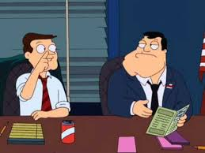
Group Activity: Statistic Slips
At each table there are 6 slips of paper
Make sure “Qu” side is up
Oldest student in the group reads first, to the youngest. (yes, learn each other’s birth months :) Take turns reading.
As a group, guess the number. Then turn over the slip to see the real number. What do you think? Discuss!
Class debrief! Surprised? Expected?
*American stats-but are Canadians that different?

Slide 7
Spending Too Much Time on Tech Can:
01
03
02
04
Social media contributes to lack of self-esteem, self image and impulsivity
Change the structure and the function of our brains
Hinder our ability to focus, think deeply and absorb what we read.
Lead to sleep problems, anxiety, stress and depression

Slide 8
How Much is Too Much Screen Time?
Shoot for less than 2 hours
Most people underestimate their screen time by 100%
Ex: If you think your screen time is around 2 hours a day, in reality, it may actually be closer to 4 hours
Find a happy balance of real life moments with productive screen time sprinkled in
How much time do you spend on your phone a day?
Notes:
🍐 This is a Pear Deck Text Slide
🍐 To edit the type of question, go back to the "Ask Students a Question" in the Pear Deck sidebar.

Slide 9
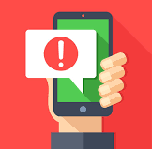
Screen Time Habits: Notifications
Russian physiologist Ivan Pavlov
Conditioned dogs to salivate whenever they hear a bell
Rang a bell every time he fed them
The dogs associate the sound of a bell with the promise of food
Got the dogs to drool in anticipation any time they heard a bell
This is exactly what happens to us when we enable push notifications
Notifications use our brains’ natural ability to associate cues with rewards
Compulsively checking our phones
Descend into a state of anticipation/anxiety/distraction everytime we hear/see a notification

Slide 10
Our Phones are Designed to Addict Us
Hooked by design
There are 1,000 social media designers whose job it is to grab your attention & steal your focus
Many technology executives limit technology for their own children
Steve Jobs
Bill Gates
The same feel-good brain chemicals that drive addictions are also released and activated when we check our phones: Dopamine activates pleasure in brains-wants to do same thing over and over (checking phones)

Slide 11
Why can’t I put down my phone?
Tristan Harris: former design ethicist at Google, where he studied ethics of human persuasion.
0:40 - 3:52

Slide 12
Time to Make a Healthier Relationship with Tech
All tech have pros and cons
Observe our technology behaviors
Eliminate the cons
Keep the good parts

Slide 13
Part 2:
Change habits to focus

Slide 14
Changing Your Habits
To Do #1: Tidying Apps
Look at the apps on your phone
Categorize all of the apps on your phone into the following 4 categories:
Optional: Install app-blocking apps
Category #1: Tool Apps
These improve your life without stealing your attention
Examples: maps, weather, camera, password manager, calendar, tasks …
Location recommendation: these are the only apps allowed on your home screen

Slide 15
Change Your Habits
To Do#1: Tidying Apps
Category #2: Utility Apps
These serve some practical purpose, but don't improve your daily life enough to be considered a tool
Examples: Find my iPhone, hotschedules
Location recommendation: Put these in a folder & relocate to your 2nd screen
Category #3: Junk Food Apps
These apps are fun or useful in limited quantities, but are hard to stop using once you start
Examples: social media, news apps, shopping apps, games
Location recommendation: Put these in a folder & relocate to your 3rd screen and/or delete these
Category #4: Clutter Apps
These are the apps that you never actually use
Example: The QR reader I installed in 2012 and haven't looked at since
Location Recommendation: delete these

Slide 16
Change Your Habits
To Do #2: Rethink Your Social Media (Select either option A or B)
Option A: Delete Social Media Apps (Not Your Account) From Your Phone
This step creates a “speed bump” to help yourself become more conscious when opening up social media - and maybe decide not to do so!
If you are hesitating remember:
It’s reversible
Can still check social media whenever you want. Check through your phone’s internet browser instead of on an app
If you are worried about forgetting your password sign up for a “password manager” app that stores your passwords

Slide 17
Change Your Habits
To Do #2: Rethink Your Social Media
Option B: Customize Your Notification Settings on your Social Media Apps
Tiktok, Instagram, Snapchat, etc:
Determine what you want to get notified about (birthdays, tags, updates, friend requests, videos…)
Determine how you want to get notified (text, email, notification push, not at all…)

Slide 18
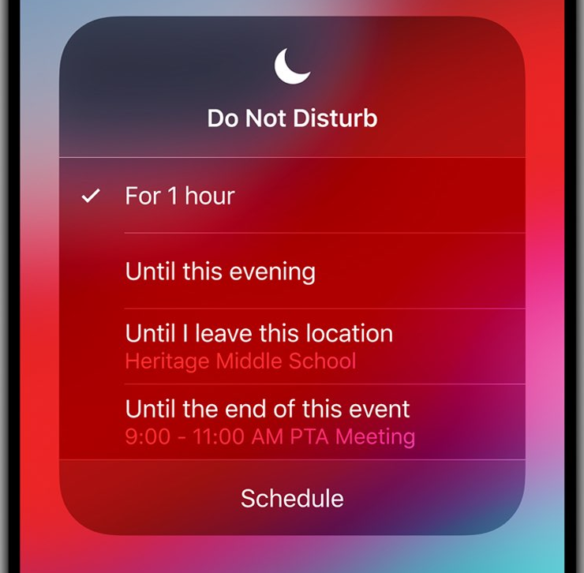
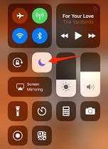
Change Your Habits
To Do #3: Keep your Phone on Silent & Do Not Disturb, especially during class time!
Click on the “Do Not Disturb” direction link for your phone.
If you are nervous about missing an important phone call you can set up features on “Do Not Disturb” so only important people can get through
Directions
Do Not Disturb - iPhone
Do Not Disturb - Android

Slide 19
Change Your Habits
To Do #4: Use a timer
Set a timer (5, 10, 15, to 30 minutes)
For the duration, focus only on the task you need to do.
After time is up, take a break.
If you are not finished the task, set timer again.
Repeat until you are done the task
Try to set for longer time periods if you are getting better at concentration. Start small, then go longer.

Slide 20
Changing Your Habits
To Do #5: Change Where You Charge it
Many of us automatically check our phones/ipads/other tech right before bed, in the middle of the night, and/or first thing in the morning, which is terrible for our sleep
Of course we are doing this: we sleep within arm’s reach of our phone
Charging station for your phone not in your room
You may need to get an actual alarm clock, if you phone is your alarm clock

Slide 21
Changing Your Habits
To Do #6: Establish No-Tech Zones
A “no-techzone” is a place where you do not use your phone or any tech
Write your no-tech zone & why you would choose this zone
Examples:
Classroom (unless for teacher directed classwork)
Dinner table
Bedroom
Lunch
Time periods
1 hour before bedtime
1 hour after waking

Slide 22
Your New Relationship
Paragraph
Using complete sentences, write a reflection paragraph of how/why you might implement these tactics to reduce screen time in your life or why you won’t.
It’s all about being aware of our habits
Submit to your teacher with your
name

